Slide 1
Validated Stage 1 Science Maturity Review for JPSS LST
Presented by Yunyue Yu
Contributors
Yuling Liu, Peng Yu, Zhuo Wang, Leslie Belsma
December 11th, 2014

Slide 2
Outline
Algorithm Cal/Val Team Members
Product Requirements
Evaluation of algorithm performance to specification requirements
  Evaluation of the effect of required algorithm inputs
  Quality analysis/validation
  Error Budget
Documentation
Identification of Processing Environment
Users & User Feedback
Conclusion
Path Forward

Slide 3
Data Product Maturity Definition
Provisional Maturity:
Product quality may not be optimal
Incremental product improvements still occurring
Version control is in effect
General research community is encouraged to participate
Users urged to consult the EDR product status
May be replaced in the archive
Ready for operational evaluation
Validated Maturity:
Product performance is defined and documented over a wide range of representative conditions via numerous and ongoing ground-truth and validation efforts
Clear documentation of product performance exists that includes all known product anomalies and their recommended remediation strategies, regardless of severity level
Product analyses are sufficient for full qualitative and quantitative determination of product fitness-for-purpose
Testing has been fully documented
Ready for long term monitoring
Product improvements continue through the lifetime of the instrument
Validated Stage 1:
Using a limited set of samples, the algorithm output is shown to meet the threshold performance attributes identified in the JPSS Level 1 Requirements Supplement with the exception of the S-NPP Performance Exclusions
Notes:
To be modified

Slide 4
LST EDR Cal/Val Team
 | Name | Institute | Function
JPSS-STAR | Ivan Csiszar | NOAA/NESDIS/SATR | Land Lead, Project Management
 | Yunyue YU | NOAA/NESDIS/SATR | TEDR Lead, algorithm development, validation, team management
 | Yuling Liu | NOAA Affiliate, UMD/ESSIC | product monitoring and validation ; algorithm development
 | Zhuo Wang | NOAA Affiliate, UMD/ESSIC | algorithm improvement
 | Peng Yu | NOAA Affiliate, UMD/ESSIC | product validation tool
 | Marina Tsidulko | NOAA Affiliate, SciTech/IMSG | STAR AIT
 | Michael EK | NOAA/EMC/NCEP | user readiness
 | Jesse Meng | NOAA Affiliate | user readiness
JPSS/DPA
 | Leslie Belsma | Aerospace Corp | algorithm Manager (JAM) for Land
NASA S-NPP Science Team
 | Miguel Roman | NSAS/GSFC | Validation data support, product monitoring
 | Sadashiva Devadiga | NASA/GSFC Affiliate, SSC | Validation data support, product monitoring

Slide 5
Requirements
Product Requirements from JPSS L1RD
Attribute | Threshold | Objective
Geographic coverage | At least 90% coverage of the globe every 24 hours (monthly average)
Vertical Coverage
Vertical Cell Size
Horizontal Cell Size | 4 km | 1 km
Mapping Uncertainty | 1 Km at Nadir (800 m) | 1 km at Edge of Scan (500m)
Measurement Range | 213 – 343 K | 183 – 343 K
Measurement Accuracy | 1.4 K | 0.8 K
Measurement Precision | 2.5 K | 1.5 K

Slide 6
History of Algorithm Changes/Updates
Date | DR# | Reason | Status
12/12/12 | 5028 | LST QA not set correctly in all-ocean granules | Closed 3/31/13. Rejected b/c No land products over ocean will ever be used; illustrates larger IDPS architecture issue that land products should not be produced over ocean
11/26/12 | 4983 | VIIRS LST beta Maturity | Closed 1/25/13 474-CCR-12-0773 deployed in ops
02/28/12 | 4608 | Split-window algorithm - Baseline Coefficient files. LUT update #2 (same as"Updated LUT" in slides): DR 4608/CCR 12-0355: Corrects errors for both dual split window and split window. | Closed 06/10/12 Split Window algorithm implemented in IDPS baseline on 10 Aug, 2012.
02/15/12 | 4582 | LST Day Night Land Water Misidentification, The LST EDR appears to have a coding error that may have incorrectly mixed up the Day/Night flag with the Land/Water and Surface Type QA Flag within the QF Byte 3 of the LST EDR... This same Day/Night flag is being correctly encoded in the bit3 of QF Byte1 of the LST EDR. | Closed 03/29/12 Rejected because EDR team did not observe such error.
09/14/11 | 4353 | Snow/ice field is always "no snow" at night if the Quarterly Surface Type does not indicate so. “Temporal snow” can only be directed daytime by snow/ ice EDR | Closed 04/26/12. Reallocated to Cryo team as new DRs: 4699 Out of Date snow cover seeded grid & 4700 Alternative snow/ice grid needed to support algorithms; Both have been addressed.
02/14/11 | 4203 | The OPS LST code, both v1.5.00.48 and v1.5.03.00, do not verify that the value for the Surface Type input falls within the valid range prior to calculating LST | Closed 1/9/13 Rejected because not a problem to LST production since LST code does check the ST.
Notes:
Need input from Leslie

Slide 7
History of Algorithm Changes/Updates
Date | DR# | Reason | Status
12/12/12 | 5027 | VIIRS LST should have NA fill in all-ocean granules | Closed IDPS initiated change implemented in IDPS Mx8.0
2/9/13 | 7055 | LST QA is “low quality” when thin cirrus/active fire is et | Closed Approved at 5/22/13 AERB Implemented in IDPS Mx8.0
5/23/13 | 7215 | VIIRS LST_SWLST LUT Update | Closed CCR-13-1089 Approved at 6/18/13 AERB Implemented in IDPS in Mx8.0
12/4/13 | 7479 | 474-CCR-13-1433 VIIRS LST Mx8.0 LST incorrect: Revert to previous SWLST LUT ASAP | Closed CCR-13-1433 Approved at 12/20/13 AERB Implemented in IDPS 12/24/134
12/17/13 | 7493 | LST_SWLST LUT Update to correct issues found in DR7215 LUTs | Closed Approved at 3/19/14 AERB Implemented in IDPS 4/7/14. LST provisional maturity effective as of implementation of this update.
Notes:
Need input from Leslie

Slide 8
Evaluation of algorithm performance to specification requirements
Findings/Issues from Provisional Review
  Strong impact of surface type uncertainty on LST quality
  Cloud contamination impact is significant
  Lack of high quality validation data set
Improvements since Provisional
  Algorithm and LUT remain the same
  Significant efforts done on validation and uncertainty analysis
  Long term monitoring tool is in development
    in use with daily/weekly/monthly/yearly maps and graphics, providing near-real time quality assessment
  Emissivity explicit algorithm is in development

Slide 9
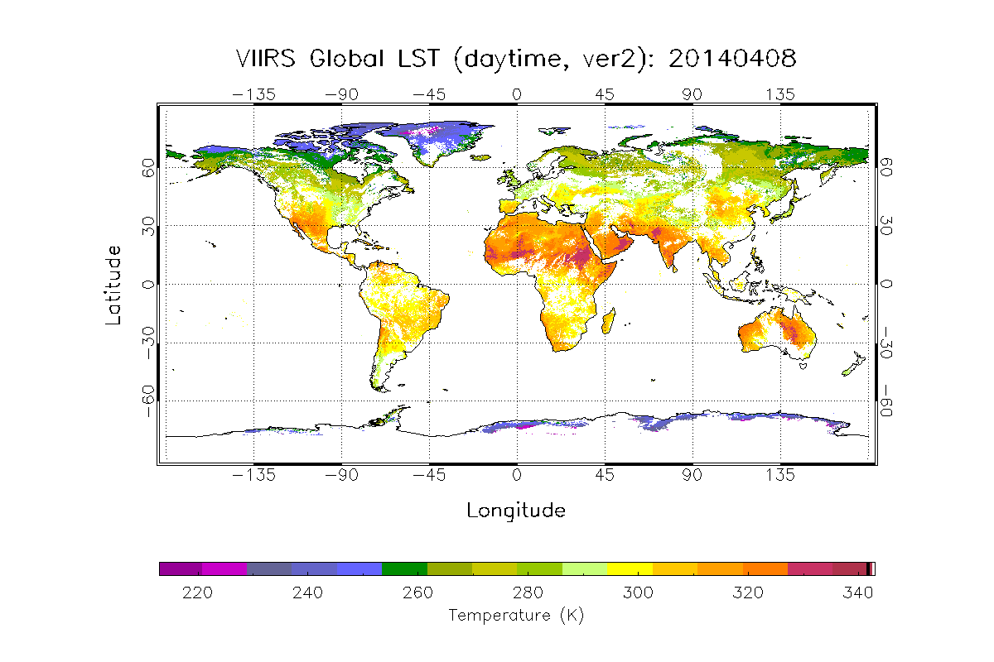
Evaluation of algorithm performance
---- monitoring tool

Slide 10
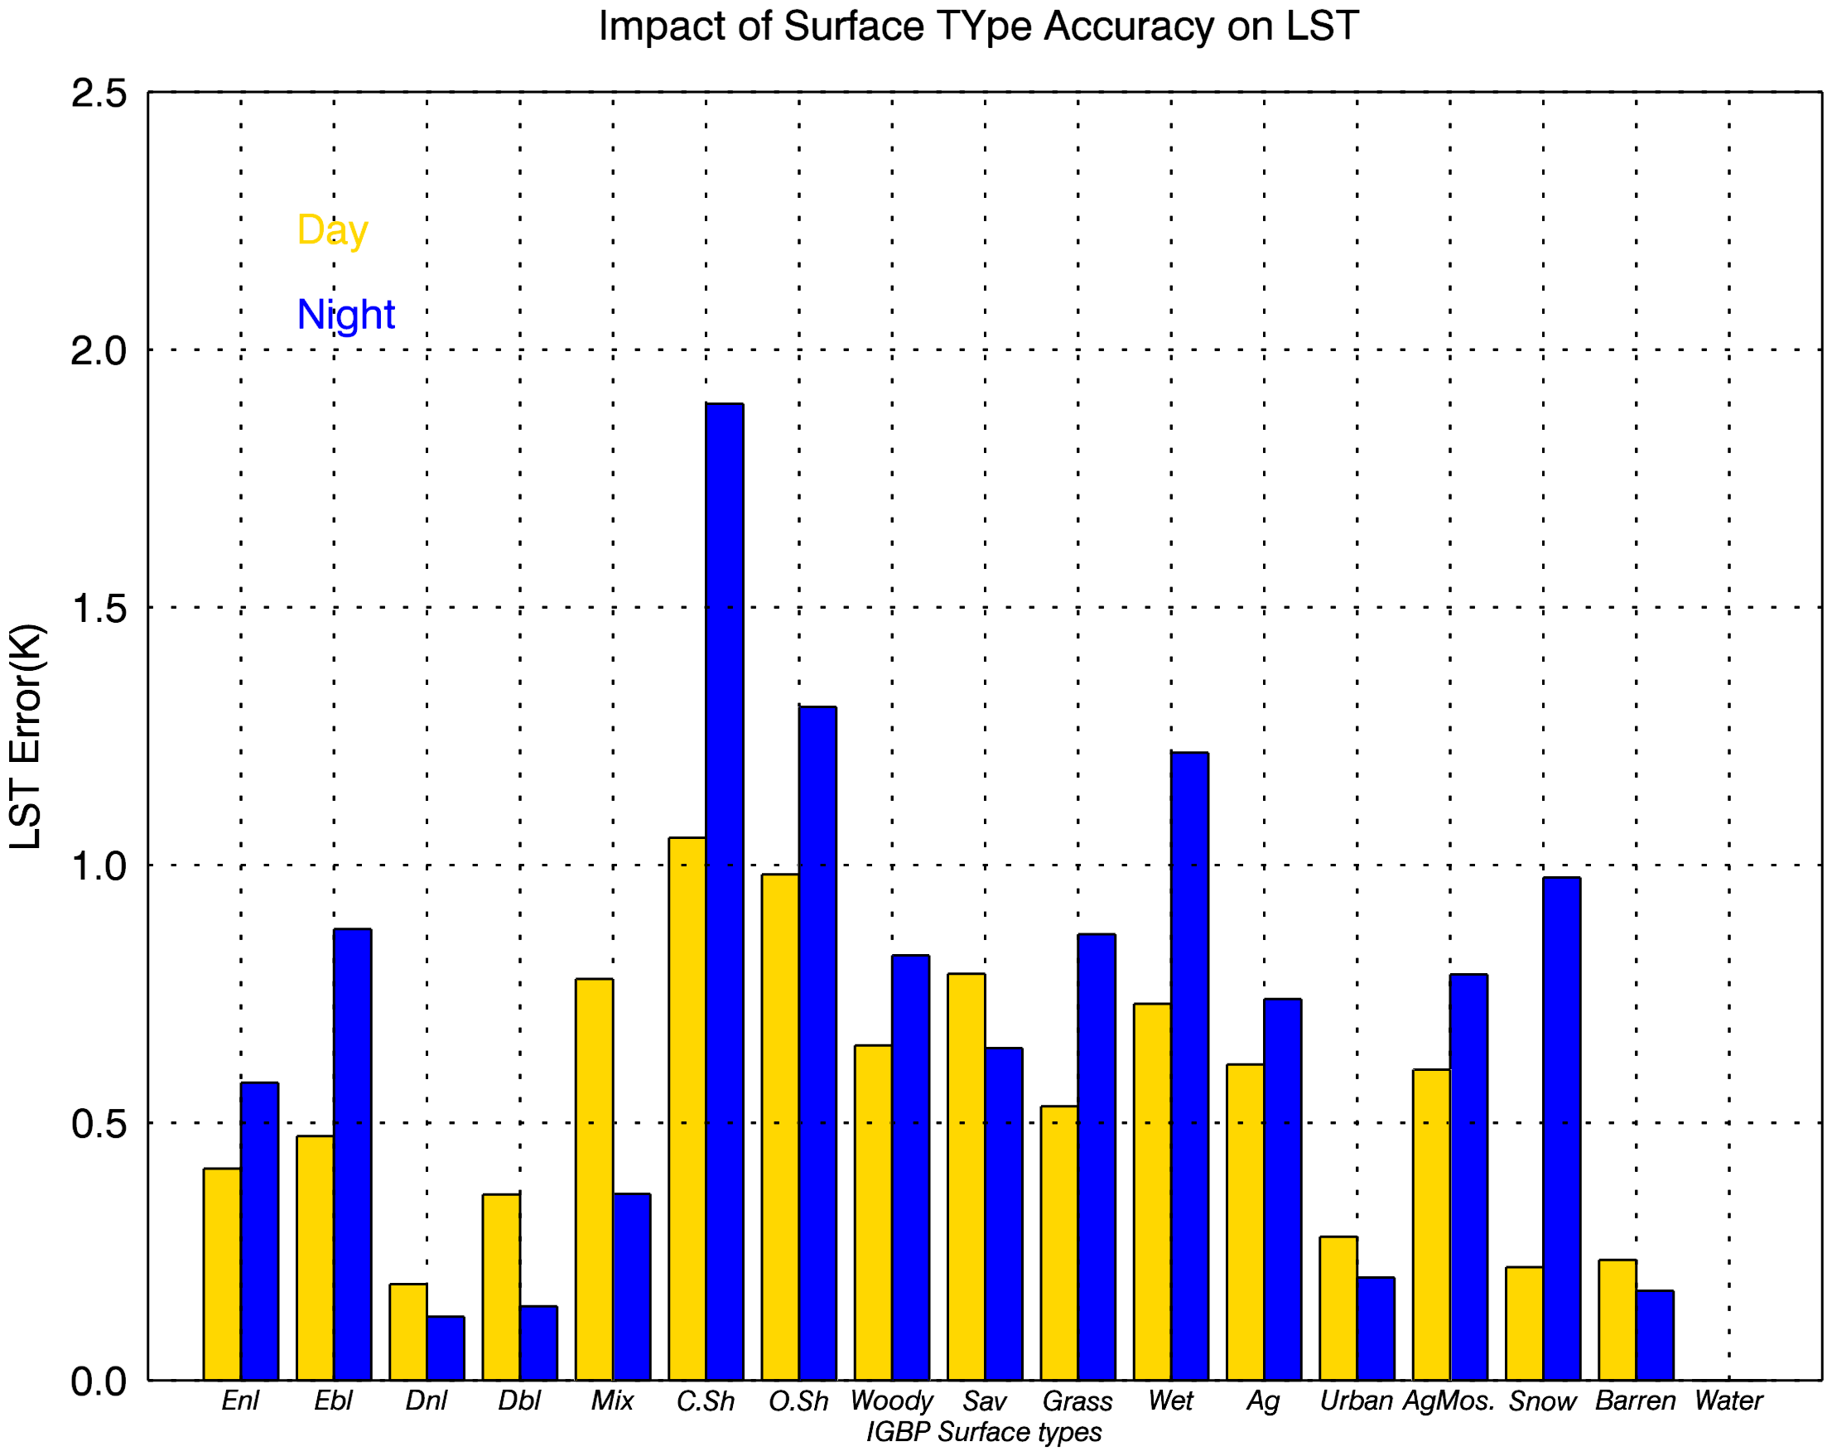


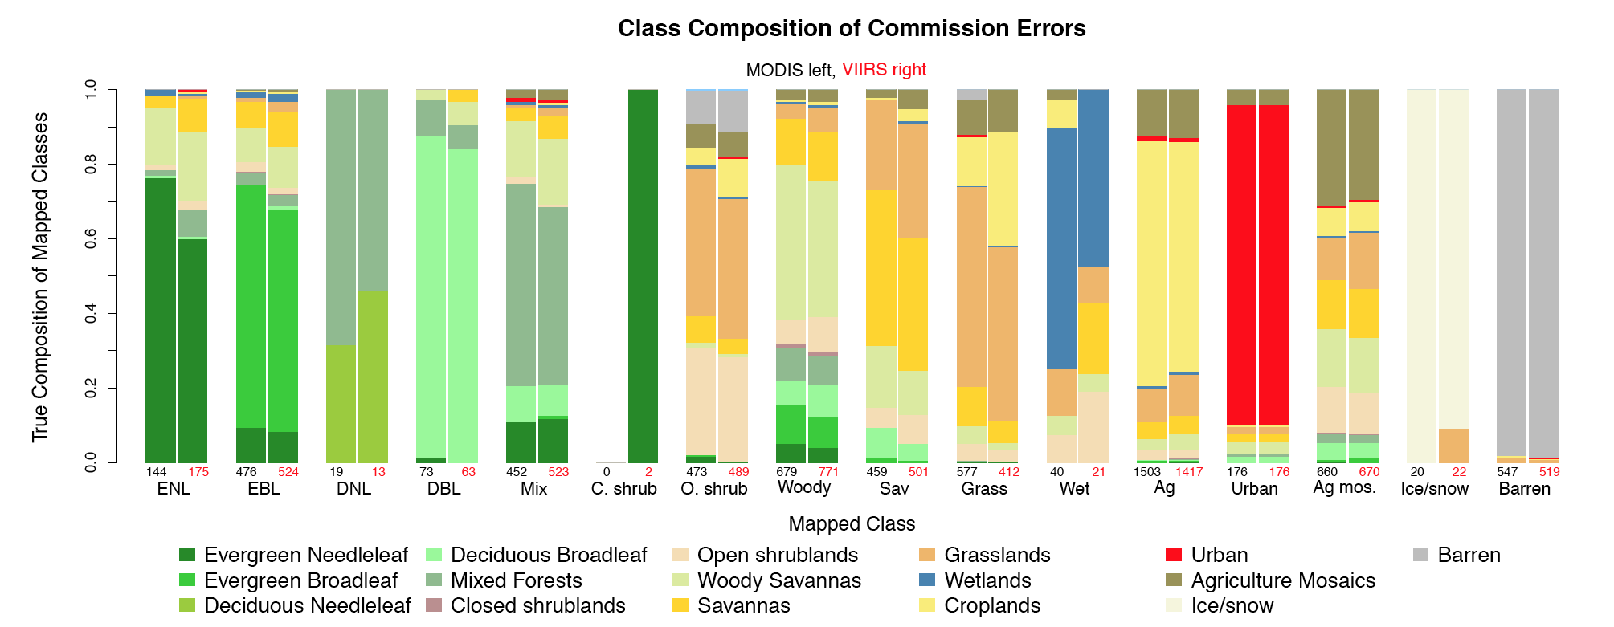
Evaluation of algorithm performance
---- Impact of ST input error (1/2)
r
is the probability of mis-classfication of surface type i (i=1,2…17) to be j (j=1,2…17)
is the LST difference between LST calculated with the equation for surface type i and with the equation for surface type j for each pixel with i surface type
represents the error for each IGBP type i under either day or night condition
represents the error for all IGBP types and all day/night conditions
represents the number of samples for surface type IGBP i
represents the total number of samples for all cases
Impact on LST (using simulation database)
Overall Statistics | Impact on LST
All-Day | 0.61
All-Night | 0.83
All | 0.73
*Reference: Damien Sulla-Menashe, VIIRS ST V1 Quality Assessment April 02, 2014 EDR meeting
Notes:
This slide shows the theoretical analysis of the impact of surface type accuracy on LST quality based on simulation data.

Slide 11


Evaluation of algorithm performance
---- Impact of Sensor Noise (1/2)
Theoretical estimation of the sensor noise impact
where
represents the error caused by sensor noise from both BT11 and BT12 for each IGBP type I under either day or night condition i (i=1,2…17) j(0:night,1:day)
represents the error caused by sensor noise from BT11
represents the error caused by sensor noise from BT12
represents noise requirements for emissive band at 11micron and 12micron, onboard the VIIRS, respectively
represents the overall error caused by sensor noise
represents the number of samples for surface type IGBP i
represents the total number of samples for all cases
and

Slide 12
Evaluation of algorithm performance
---- Impact of Sensor Noise (2/2)
Sensor noise level :
σ = 0.070 K
Overall Statistics | Impact on LST*
All-Day | 0.197K
All-Night | 0.199K
All | 0.198K
*Impact on LST is estimated using simulation database

Slide 13

Evaluation of algorithm performance
---- Impact of input errors (overall)
Theoretical estimation of the overall impact
represents the overall LST uncertainty
represents the uncertainty caused by surface type
represents the uncertainty caused by sensor noise
is the algorithm uncertainty, estimated in the coefficients regression procedure bases only on the simulation data.
Overall Statistics | Uncertainty by Surface Type Accuracy | Uncertainty by Sensor Noise | Algorithm Uncertainty | Overall LST product Uncertainty**
All | 0.73 | 0.198 | 0.46 | 0.88
All-Day | 0.61 | 0.197 | 0.42 | 0.77
All-Night | 0.83 | 0.199 | 0.51 | 0.99
**Impact on LST is estimated using simulation database
Notes:
Why night time number is big?
Yuling: I saw the question"why nighttime uncertainty is larger than daytime". I actually have the same question.
The reason I think is the data selection form the emissivity pair for each IGBP type. The same pair is used for both day and night, which might cause over/under estimation of uncertainty.
But we need to do some test to verify my thought.

Slide 14
Evaluation of algorithm performance
---- Impact of ST input error (2/2)
Overall Statistics | Impact on LST
All-Day | 1.5K
All-Night | 0.8K
All | 1.2K
Impact on LST using real orbit data on Oct. 22, 2014, daytime (top) and nighttime(bottom)
Notes:
Although the input error is acceptable from the simulation data analysis, the real data computation shows significant larger imapct.

Slide 15
Quality Analysis/Validation
Quality analysis and validation studies on
Ground measurements
  SURFRAD
  CRN
  Africa data
  China
Radiance based validation
  Global (9 areas selected)
Cross satellite comparison
  MODIS Aqua LST
  MSG SEVIRI LST

Slide 16
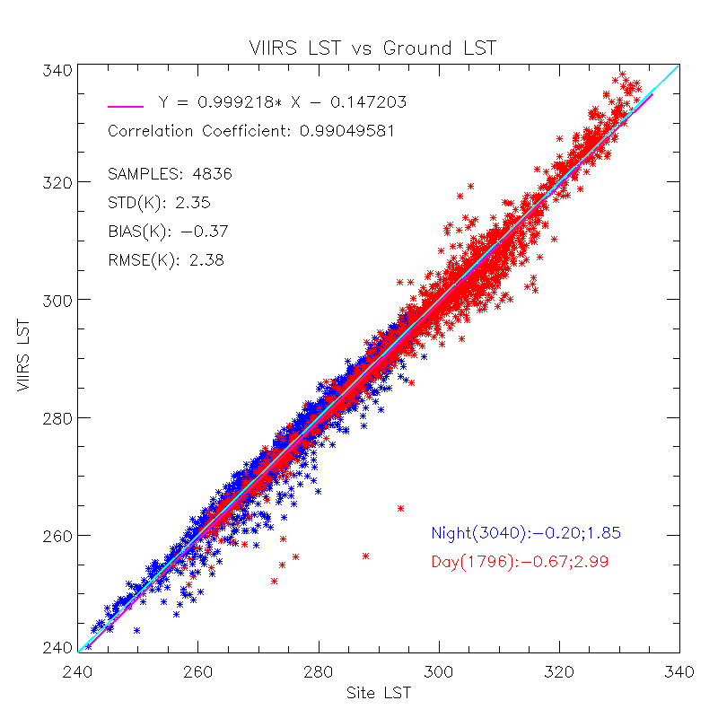
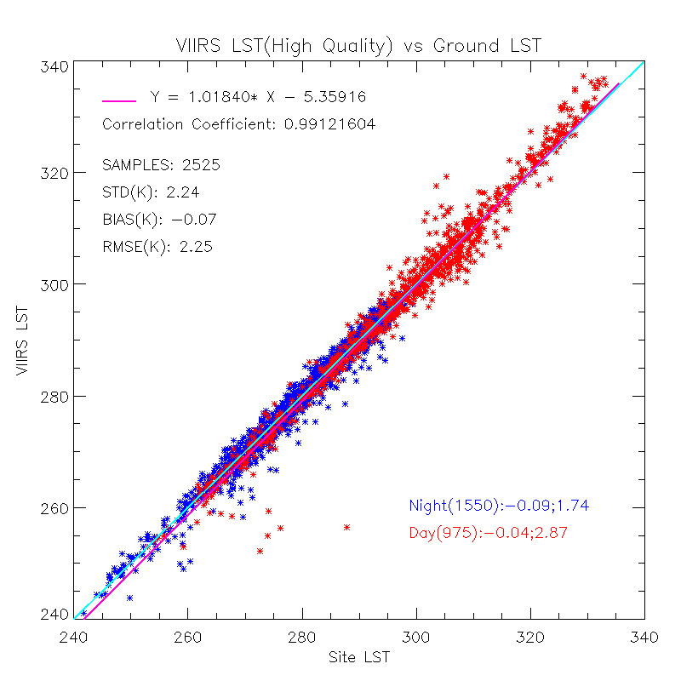
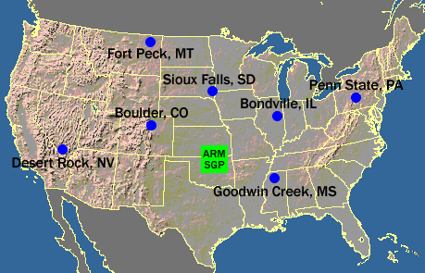
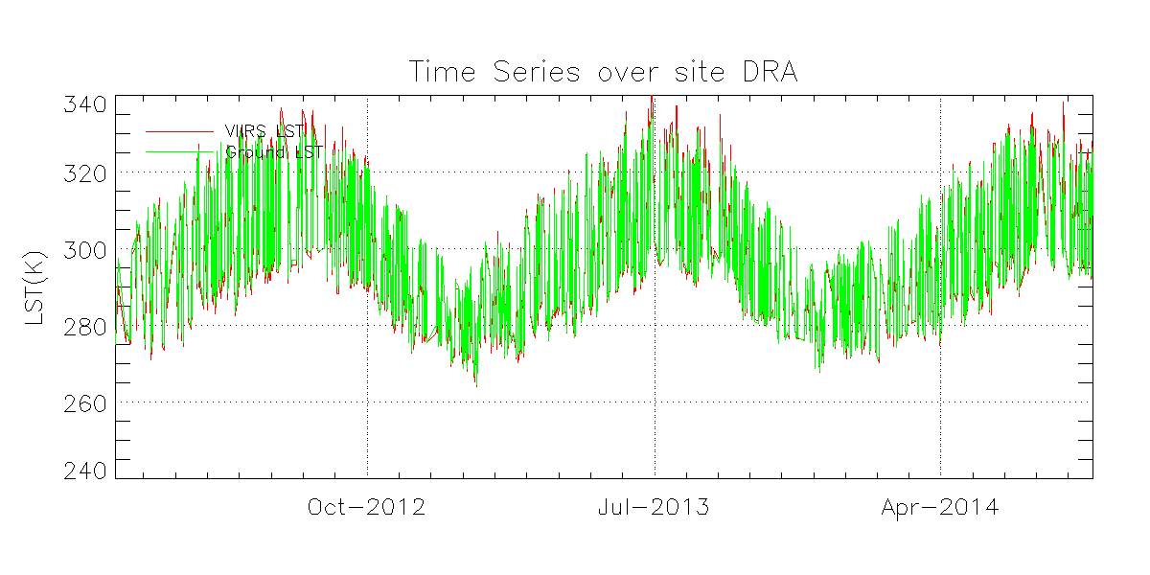
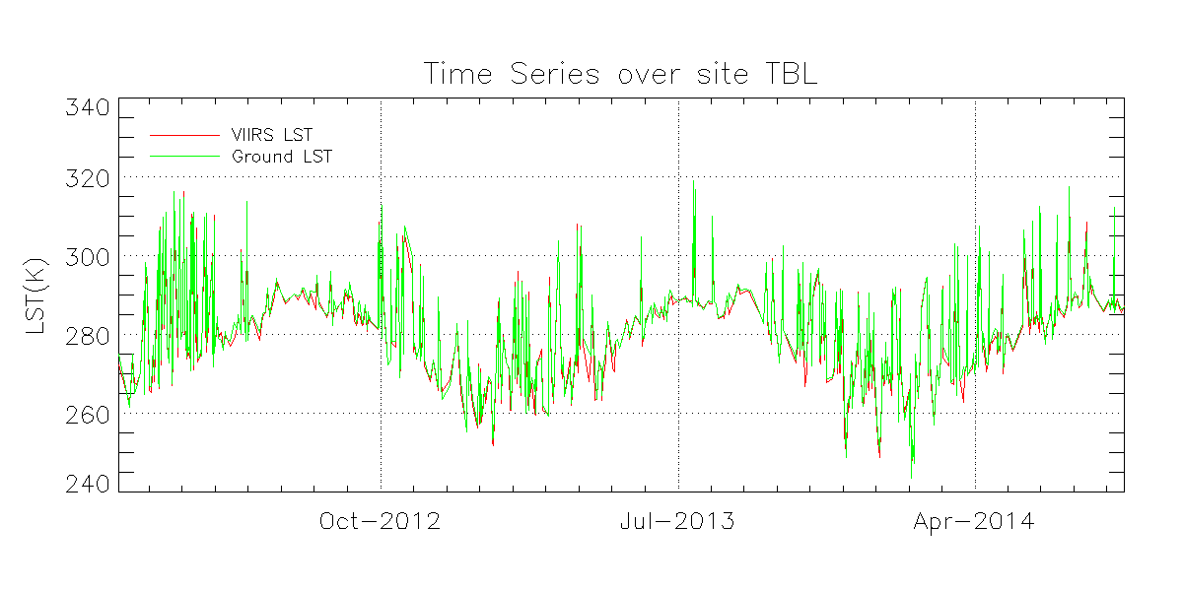
Quality Analysis/Validation
---- SURFRAD Sites (1/2)
Season | Samples | Overall |  | Day |  | Night
 |  | Bias | STD | Bias | STD | Bias | STD
Spring | 1297 | -0.54 | 2.78 | -0.69 | 3.82 | -0.46 | 1.97
Summer | 1403 | -0.1 | 2.43 | -0.87 | 3.68 | 0.26 | 1.39
Fall | 1160 | -0.28 | 1.9 | -0.32 | 2.04 | -0.24 | 1.79
Winter | 976 | -0.65 | 2.01 | -0.83 | 1.65 | -0.53 | 2.21
IGBP type | Samples | Overall |  | Day |  | Night
 |  | Bias | STD | Bias | STD | Bias | STD
4 | 18 | -1.41 | 3.01 | -1.82 | 2.66 | -1.26 | 3.22
6 | 96 | -0.98 | 1.41 | -0.5 | 1.88 | -1.32 | 0.84
7 | 955 | -0.2 | 1.59 | 0.24 | 2.06 | -0.61 | 0.79
8 | 286 | 0.19 | 2.56 | -1.7 | 2.6 | 1.38 | 1.66
10 | 1048 | -0.49 | 1.81 | -0.85 | 2.3 | -0.37 | 1.59
12 | 1238 | -0.35 | 2.68 | -0.63 | 3.8 | -0.22 | 1.91
14 | 857 | -0.28 | 2.54 | -1.28 | 2.4 | 0.19 | 2.47
15* | 189 | -1.72 | 4.31 | -1.72 | 4.31
16 | 149 | -0.23 | 1.55 | 0.87 | 1.67 | -1.04 | 0.75
Notes:
This slide shows the validation against ground LST measurement from SURFRAD. Seven sites are included and the time span is from Feb. 2012 to Aug.2014.
the overall results under cloud clear condition for all angle measurements and the spatial stddev of the 3*3 pixel < 1.5 K to avoid possible undetected clouds.
The right top figure shows the results for high quality data only. As shown in the figure, overall bias is -0.37 and std is 2.35, marginally meet the requirement. Note the matchups with large discrepancies, which shows a much lower LST retrieval compared to ground LST, is suspiciously cloud contaminated.
Left bottom shows the long term monitoring of the LST quality. An obvious diurnal and seasonal LST change is observed.
Up-table: LST quality is found with significant seasonal feature, a better agreement in fall and winter compared to that in Spring and Summer.
Bottom-table: the quality varies over surface type and day/night conditions. Note that over IGBP 15, snow/ice surface, only daytime snow is available , nighttime snow is recently implemented from the DR. . Also note that the large discrepancies are all over snow/ice surface, suggesting that cloud masking over snow and ice surfaces is still problematic and has a significant impact on the retrieval quality of LST.

Slide 17
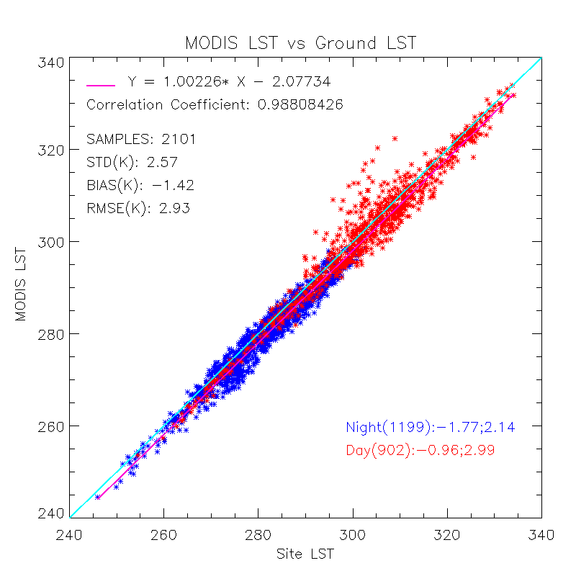
Quality Analysis/Validation
---- SURFRAD Sites (2/2)
VIIRS Data: Feb. 2012 – Aug. 2014
MODIS Data: Jan. 2012 – Jul. 2013
Notes:
This slide shows the comparison of VIIRS LST and MODIS LST against SUFRAD data.
1)The same cloud screening procedure is applied for both processing.
2) The result shows that VIIRS LST achieves comparable performance compared to MODIS LST. Both are found colder than ground LST and some warmer LST retrieval at daytime.
3) Differences are found : cloud contamination for VIIRS LST, nighttime VIIRS LST is warmer than MODIS LST estimation.

Slide 18
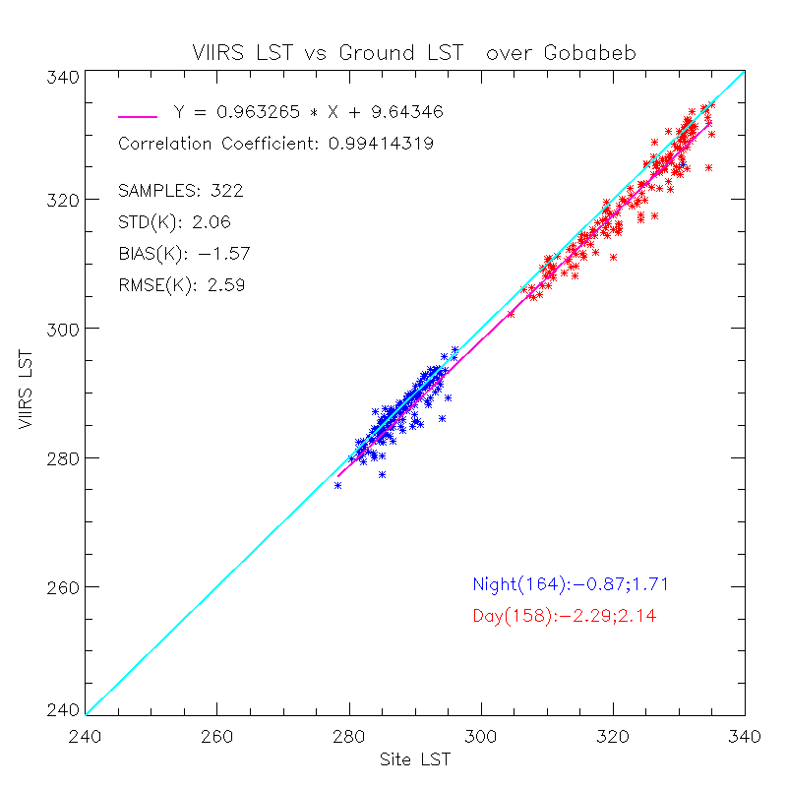
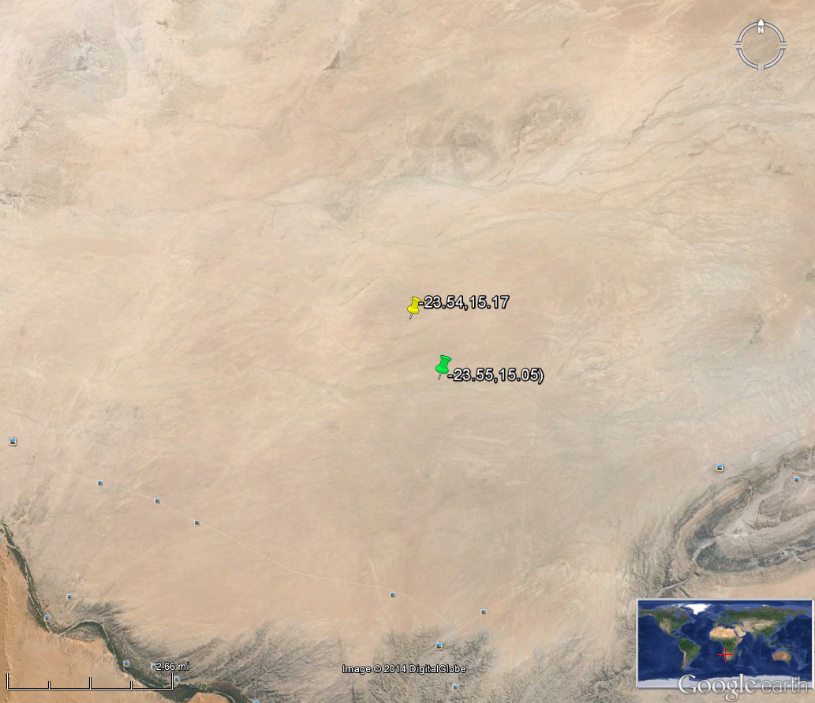
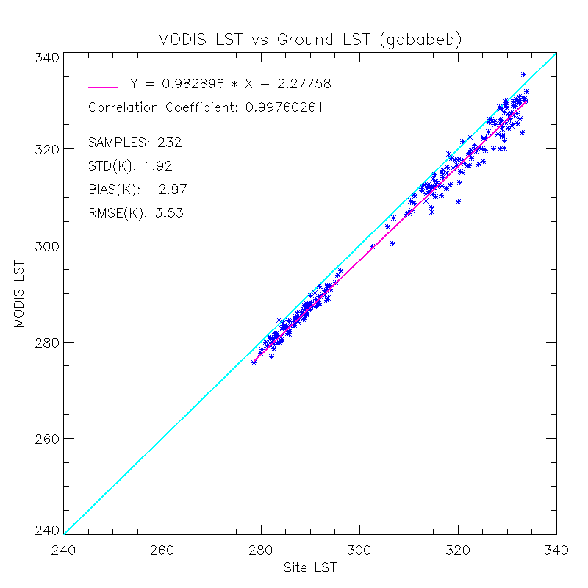
Quality Analysis/Validation
---- Africa Site*
Suggested for matchup
Sensor Location
VIIRS LST
*the Africa site data provided by Frank Goettsche (KIT & EUMETSAT Land SAF), through LST validation collaboration
MODIS v5 LST
Notes:
This slide shows the validation result against the ground LST measurement in Africa. The result from MODIS is also shown as a reference.
An obvious underestimation is found for both VIIRS LST and MODIS LST comparing to the ground measurements, 3K and 1.6K for MODIS V5 LST and VIIRS LST, respectively.
Considering the homogeneity of the surface, a different location is suggested for matchup(yellow) from the sensor location (green mark), where it is a bit hilly in topography.

Slide 19
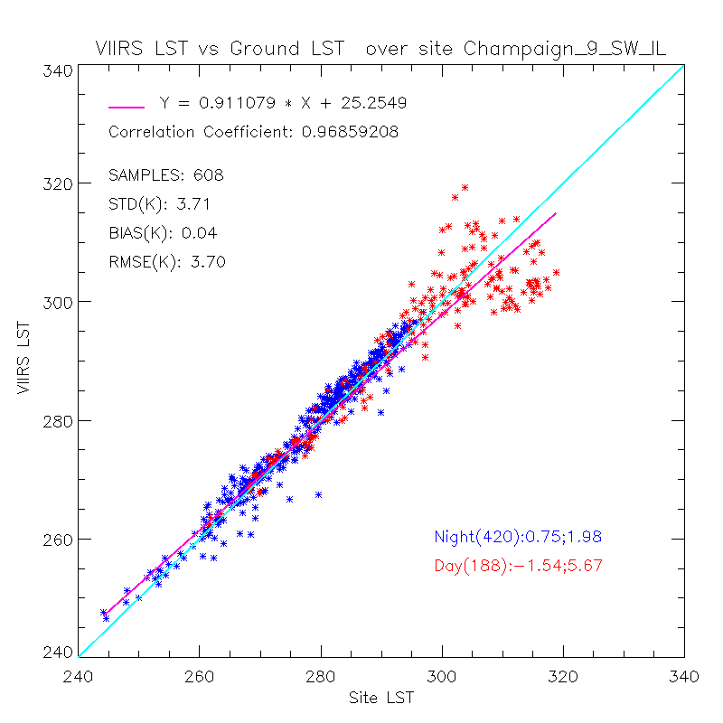
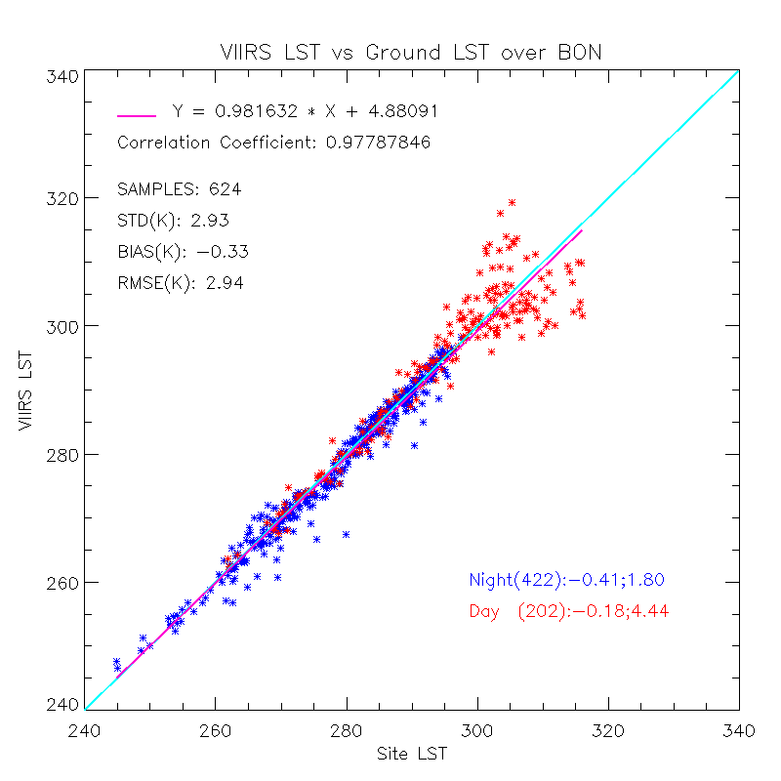
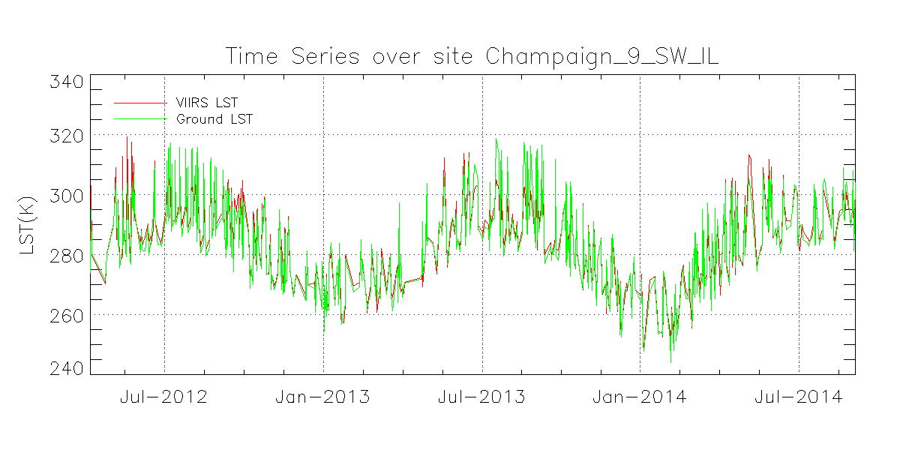
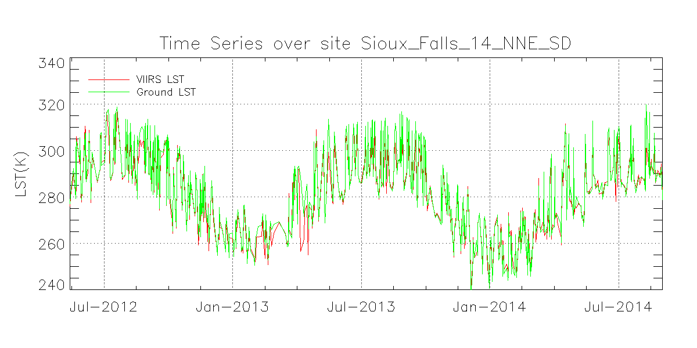
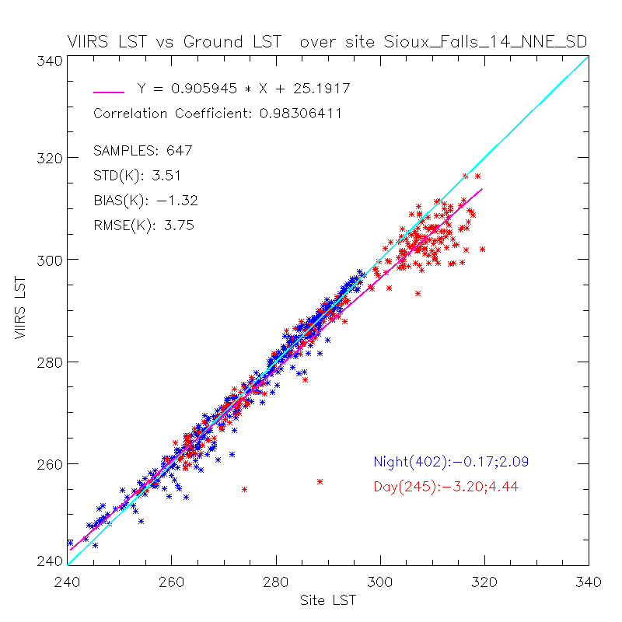
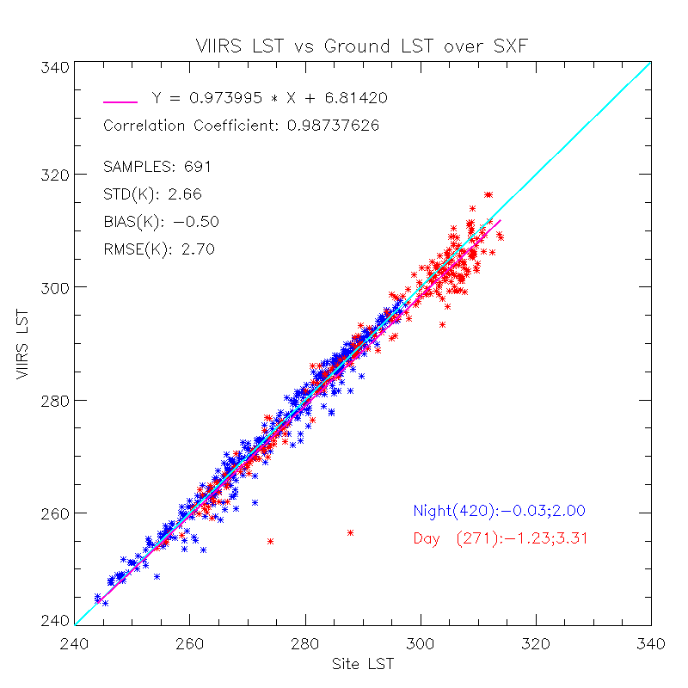
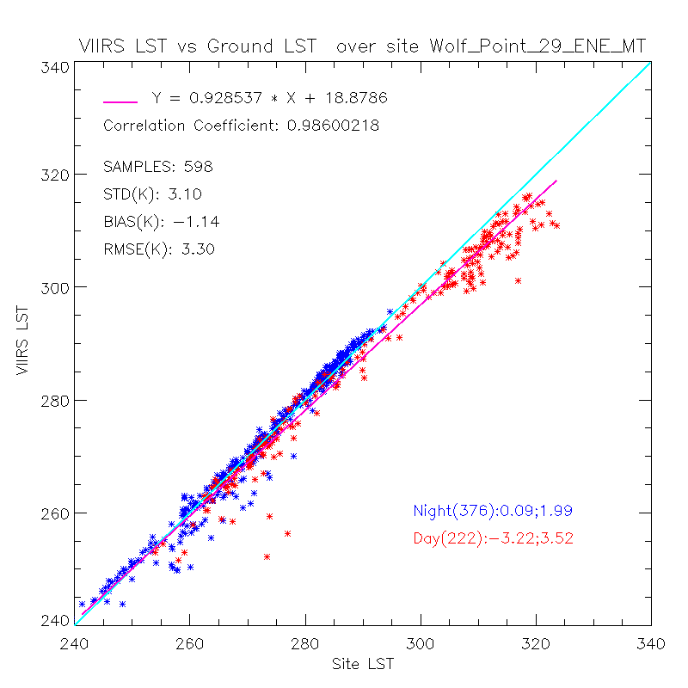
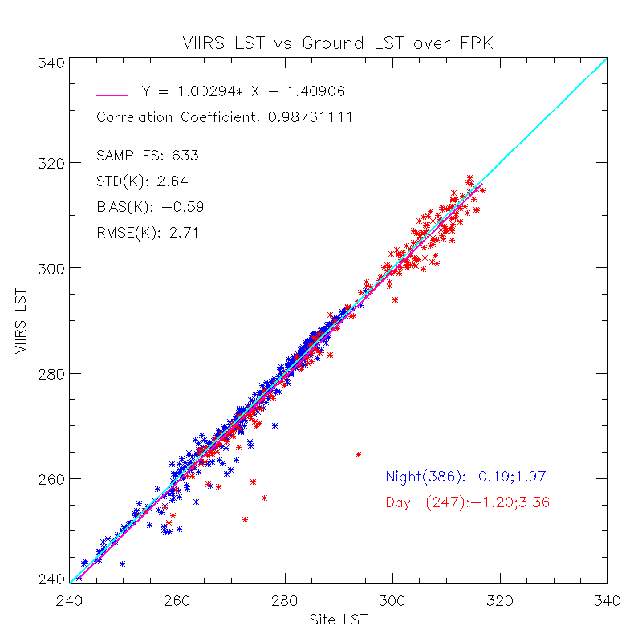
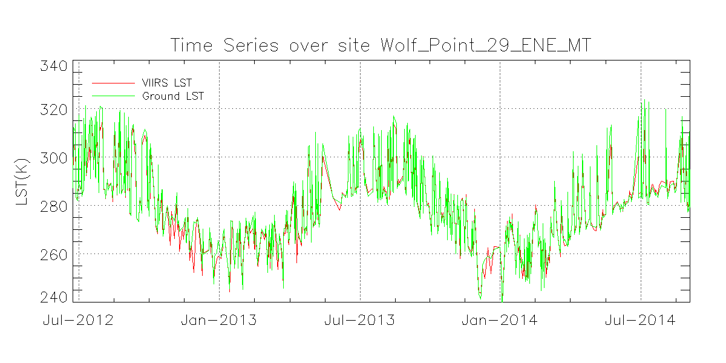
Quality Analysis/Validation ---- CRN Sites (1/2)
CRN
SURFRAD
Notes:
The validation result from CRN sites are also presented as a reference.
There are over 100 stations in CRN network but here only three of them are chosen as these are collocated with Surfrad sites.
This slide shows that the discrepancies are significantly larger in the comparisons with CRN measurements compared to SURFRAD measurements. It reflects validation difficulties from ground data quality control.

Slide 20
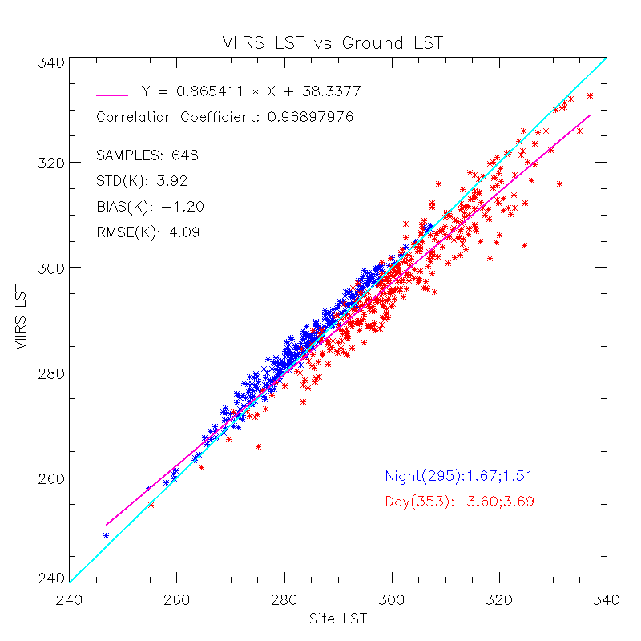

Quality Analysis/Validation
---- CRN Sites (2/2)
VIIRS
Corresponding matchups for VIIRS and MODIS:
Time span: Jul. 2013 – Sep. 2014
Data: same site, same day, satellite zenith angle within 10 degree
MODIS
Notes:
This slide shows the comparison of VIIRS LST and MODIS LST against CRN measurements.
1)The same cloud screening procedure is applied for both processing.
2) Result shows that VIIRS LST achieves comparable performance to MODIS LST. Both are found colder than ground LST at daytime and warmer than ground measurement at nighttime.
3) Differences are found: nighttime VIIRS LST is warmer than MODIS LST estimation.

Slide 21
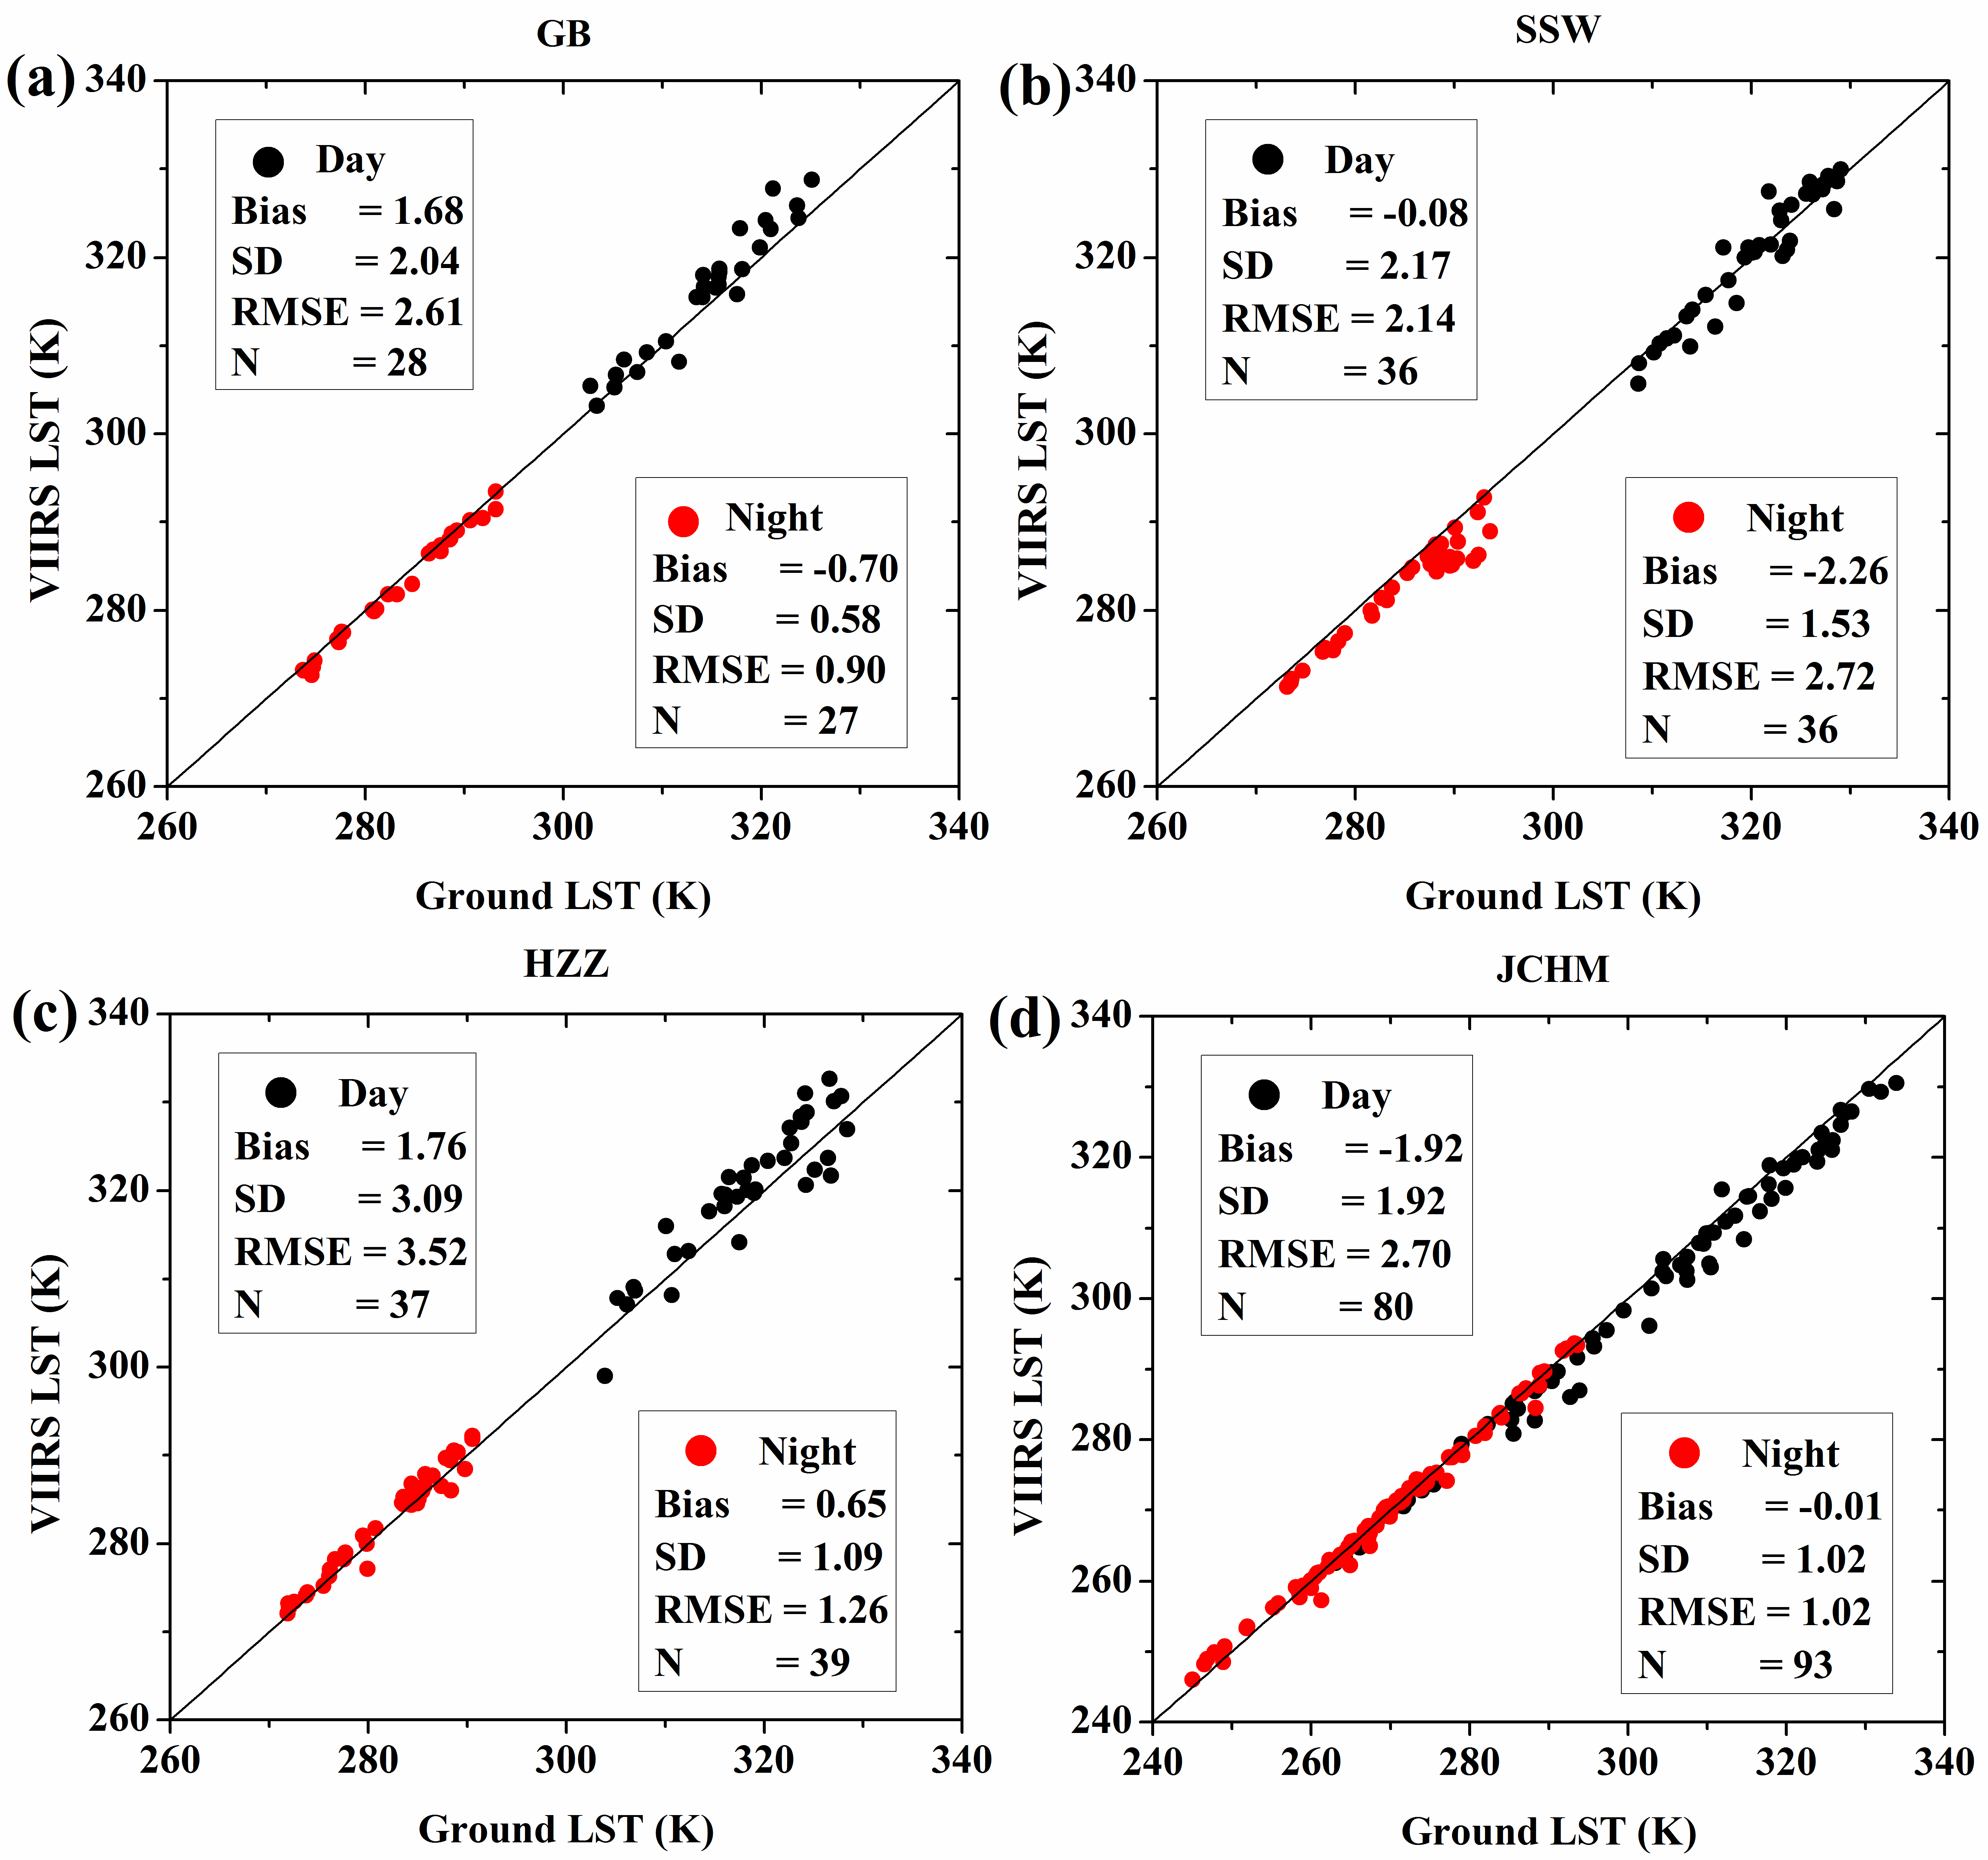
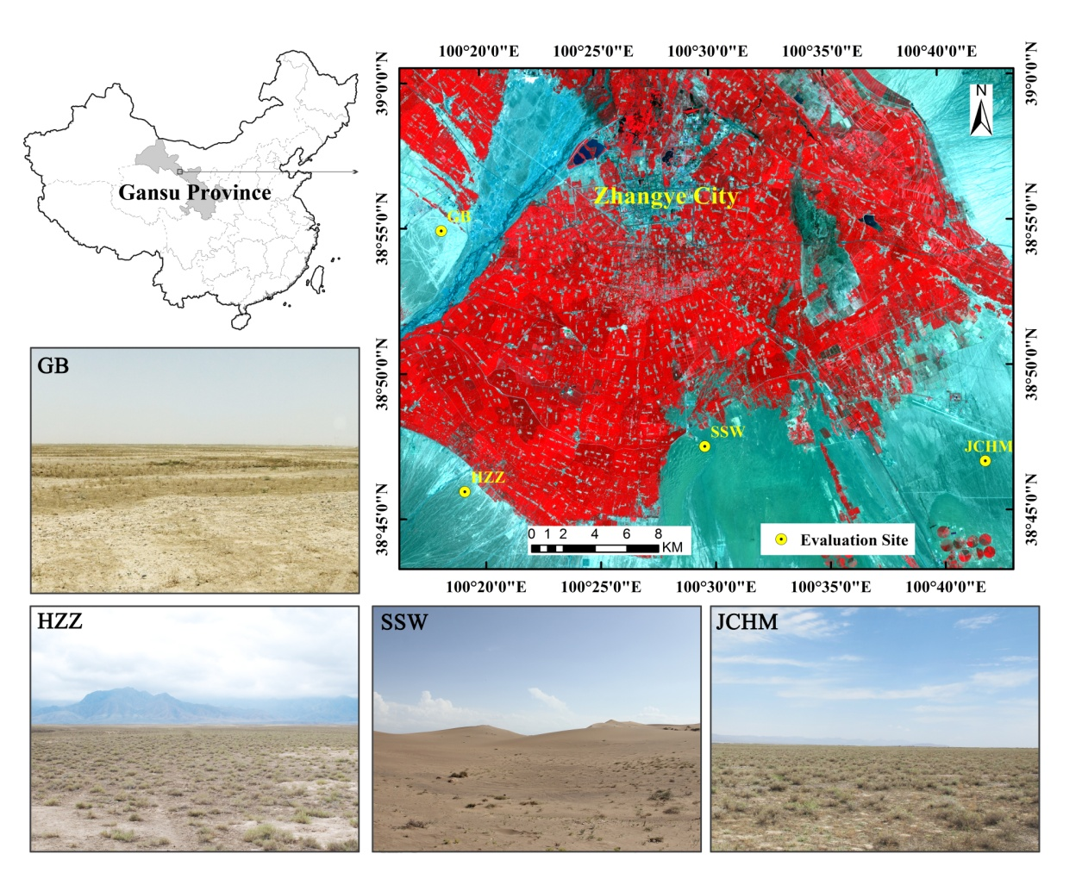
Quality Analysis/Validation
---- China Sites* (2/2)
VIIRS LST-Beta Maturity
MODIS Aqua LST
Data collection: arid area of northwest China (Heihe Watershed Allied Telemetry Experimental Research), from June 2012 to April 2013. Four barren surface sites were chosen for the evaluation.
The result generally shows a better agreement for VIIRS LST than that for MODIS LST.
*the China site data provided by Hua Li (China Academy of Science), through LST validation collaboration
Reference: H. Li, D. Sun, Y. Yu, H. Wang, Y. Liu, Q. Liu, Y. Du, H. Wang and B. Cao(2014) , Evaluation of the VIIRS and MODIS LST products in an arid area of Northwest China Remote Sensing of Environment 02/2014; 142:111–121.
Notes:
This slide shows the validation result in China. You can find more details in the publication shown in the bottom.
The data is collected in an arid area of northwest China during the Heihe Watershed Allied Telemetry Experimental Research (HiWATER).
Four barren surface sites were chosen for the evaluation, which took place from June 2012 to April 2013.
But note that the data for VIIRS is in beta maturity. We have not
The result generally shows a better agreement for VIIRS LST than that for MODIS LST.

Slide 22
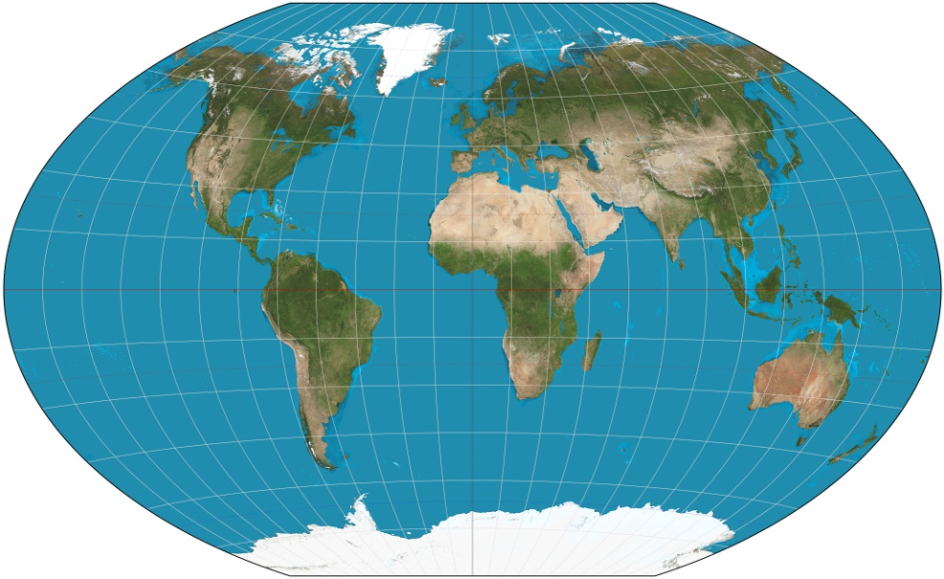
Quality Analysis/Validation
---- Radiance based validation
Validation Results over areas
6
Areas | Overall |  |  | Day |  |  | Night
 | Samples | Bias | STD | Samples | Bias | STD | Samples | Bias | STD
Algeria | 850088 | 1.41 | 0.79 | 110433 | 0.22 | 0.56 | 739655 | 1.59 | 0.66
Australia | 5164739 | 0.54 | 1.27 | 3021553 | -0.18 | 1.05 | 2143186 | 1.56 | 0.72
Brazil | 3436612 | 0.48 | 0.89 | 1002784 | -0.32 | 0.94 | 2433828 | 0.81 | 0.61
China | 1603865 | 0.83 | 0.91 | 528628 | 0.15 | 0.8 | 1075240 | 1.17 | 0.17
France | 3014553 | 0.07 | 0.93 | 1530488 | -0.53 | 0.91 | 1484065 | 0.70 | 0.39
Greenland | 1059702 | 0.08 | 0.55 | 294543 | 0.62 | 0.50 | 765159 | -0.13 | 0.41
Gobabeb | 959981 | 0.52 | 1.53 | 595335 | -0.5 | 0.75 | 364646 | 2.18 | 0.90
Indian | 2482012 | 0.39 | 1.23 | 656915 | -0.98 | 1.53 | 1825097 | 0.88 | 0.54
USA | 3408392 | 0.43 | 1.17 | 1565562 | -0.41 | 0.85 | 1842830 | 1.14 | 0.92
9
7
8
2
4
1
3
5
Results over surface type
SurfaceType | Overall |  |  | Day |  |  | Night
 | Samples | Bias | STD | Samples | Bias | STD | Samples | Bias | STD
Evergreen Needleleaf Forests | 216593 | 0.19 | 0.54 | 70324 | -0.22 | 0.54 | 146269 | 0.38 | 0.41
Evergreen Broadleaf Forests | 207839 | -0.4 | 0.97 | 107698 | -0.68 | 1.02 | 100141 | -0.09 | 0.82
Deciduous Needleleaf Forest | 13554 | 0.25 | 0.74 | 5932 | -0.44 | 0.46 | 7622 | 0.78 | 0.42
Broadleaf Forests | 385231 | 0.22 | 0.55 | 204843 | -0.05 | 0.56 | 180388 | 0.54 | 0.32
Mixed Forests | 597413 | -0.02 | 0.8 | 359702 | -0.42 | 0.76 | 237711 | 0.59 | 0.34
Closed Shrublands | 92393 | 0.94 | 1.13 | 30537 | -0.21 | 0.97 | 61856 | 1.5 | 0.69
Open Shrublands | 5906708 | 0.72 | 1.29 | 3305495 | -0.22 | 0.85 | 2601213 | 1.92 | 0.53
Woody Savannahs | 917791 | 0.31 | 0.7 | 407793 | -0.12 | 0.65 | 509998 | 0.66 | 0.52
Savannahs | 3142202 | 0.48 | 0.81 | 1008898 | -0.22 | 0.81 | 2133304 | 0.81 | 0.56
Grasslands | 1124800 | -0.07 | 1.42 | 517457 | -1.2 | 1.25 | 607343 | 0.9 | 0.6
Permanent Wetlands | 28282 | 0.02 | 0.54 | 4013 | 0.09 | 0.91 | 24269 | 0.01 | 0.45
Croplands | 4072551 | 0.15 | 1.2 | 1491236 | -1.02 | 1.21 | 2581315 | 0.82 | 0.44
Urban Built-Up | 190876 | 0.27 | 0.52 | 89295 | 0.04 | 0.5 | 101581 | 0.47 | 0.45
Croplands/Natural Vegetation Mosiacs | 1276644 | 0.31 | 0.56 | 543193 | -0.08 | 0.45 | 733451 | 0.59 | 0.45
Snow Ice | 1142843 | 0.04 | 0.51 | 336615 | 0.54 | 0.55 | 806228 | -0.17 | 0.31
Barren | 2389775 | 1.29 | 0.89 | 699333 | 0.54 | 0.75 | 1690442 | 1.6 | 0.75
Water Bodies | 161468 | -0.22 | 0.86 | 45826 | -0.35 | 1.35 | 115642 | -0.16 | 0.55
Over temperature range
Temp. Range | Samples | Bias | STD | RMSE
220-230 | 12978 | -0.05 | 0.18 | 0.19
230-240 | 355782 | -0.08 | 0.28 | 0.29
240-250 | 622961 | 0.1 | 0.57 | 0.58
250-260 | 371442 | 0.54 | 0.56 | 0.78
260-270 | 303642 | 0.75 | 0.72 | 1.04
270-280 | 1648372 | 0.89 | 0.78 | 1.18
280-290 | 3732633 | 1.05 | 0.82 | 1.33
290-300 | 7990823 | 0.89 | 0.92 | 1.28
300-310 | 2173475 | -0.52 | 1 | 1.13
310-320 | 2481185 | -0.51 | 1 | 1.12
320-330 | 1578097 | -0.22 | 1.26 | 1.28
330-340 | 465266 | -0.01 | 1.28 | 1.28
Notes:
This slide shows the radiance based validation result.
1) 9 areas are selected to represent the global coverage as shown in the global map. Considering that some IGBP types particularly vegetation types may have seasonal feature, granules representing each season are selected for this study.
2) atmospheric profiles used are from the National Center for Environmental Prediction (NCEP) Global Forecast System (GFS) at 0.5°×0.5° resolution, with global atmospheric fields every 6 hours. The radiative transfer model MODTRAN 5.1 is used in this analysis
3)VIIRS LST overall agrees well with the radiance calculated LST with an average bias of 0.53, and std of 1.03.
4) It also demonstrate a regional difference and day/night difference: the best agreement is found over Greenland with a bias of 0.08 and STD of 0.55; a smaller bias and a larger STD is found at daytime compared to that at nighttime.
5) The performance over surface type and temperature range is also analyzed. VIIRS LST agrees better with radiance calculated LST over evergreen needle leaf forest, Broadleaf Forests, Permanent Wetlands, Urban Built-Up, Croplands/Natural Vegetation Mosiacs and snow/ice surface. Relatively large difference is found over arid and semi-arid surface types such as closed shrubland, open shrubland and barren surface.
6) Regarding the performance over temperature range, it is found that generally it agrees better at lower temperature end and the discrepancies increase with temperature particularly after 280K, reaching 1.3 for RMSE and after 320K, reaching 1.28 for RMSE.
.

Slide 23
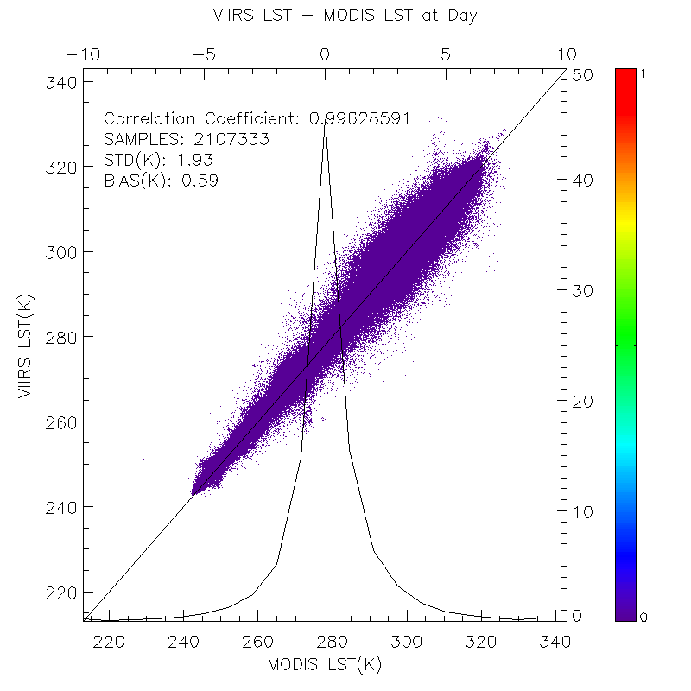
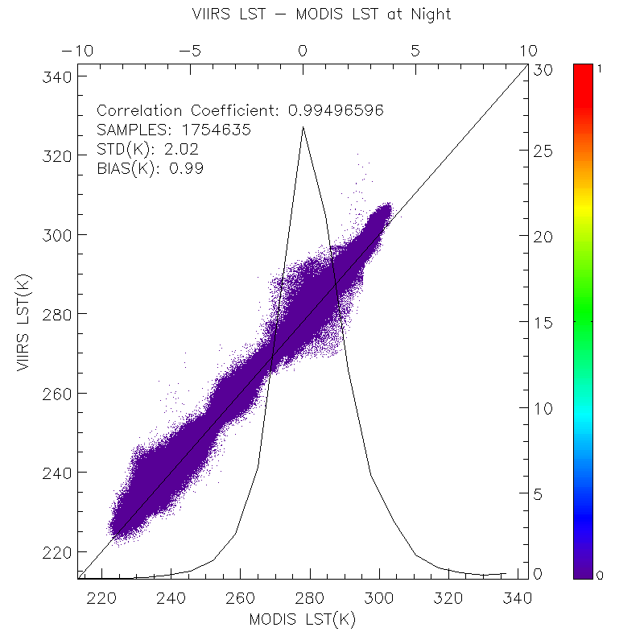
Quality analysis/validation
---- Cross satellite comparison (MODIS)
Cross Satellite Comparison: VIIRS vs MODIS Aqua LST (granules)
Comparison results from Simultaneous Nadir Overpass (SNO) between VIIRS and AQUA in 2012 over US , Oct-Dec, 2013 over US, polar and low latitude (over 100 scenes). The matchups are quality controlled for both LST measurements.
Notes:
This slide shows the cross comparison results between VIIRS and MODIS LST at granule level.
1) SNO service is used in this analysis. Over 100 scenes are included covering the polar area, low latitude area and US area.
Both LST are quality controlled.
2) The difference is within our expectation as it is affected by sensor difference, time difference, viewing angle difference and quality control procedures.

Slide 24
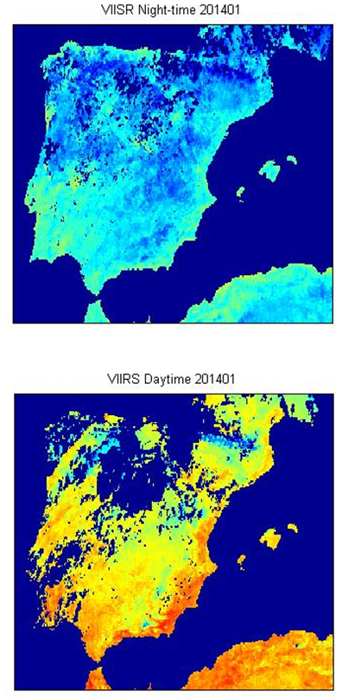
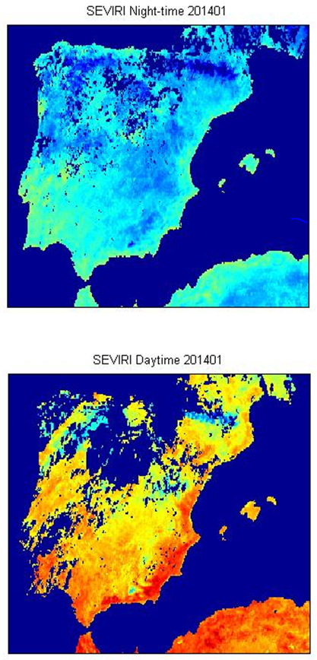
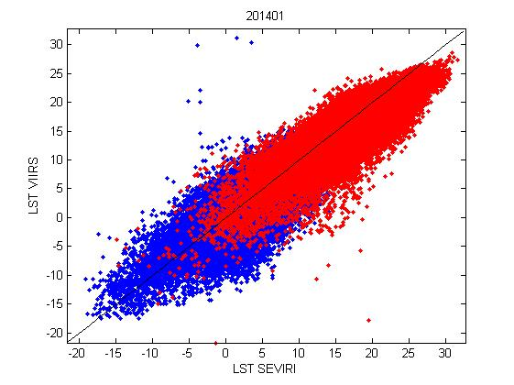
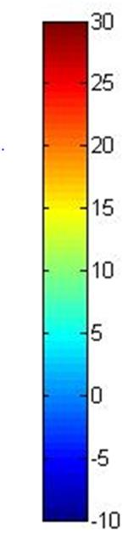
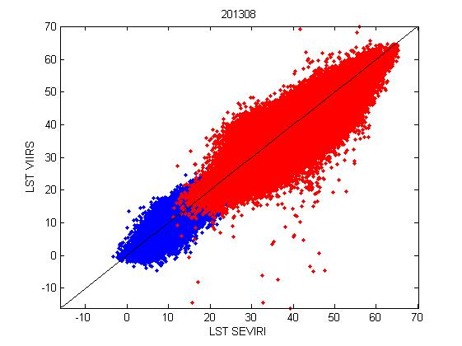
Quality Analysis/Validation
---- Cross satellite comparison (SEVIRI)
VIIRS
1-9 Jan 2014
SEVIRI
Jan. 1-9
Night-time
Bias = -0.15 ºC
RMSE = 2.16 ºC
Daytime
Bias = -2.02 ºC
RMSE = 2.81 ºC
Aug. 1-9
Night-time
Bias = +0.26 ºC
RMSE = 1.55 ºC
Daytime
Bias = -2.95 ºC
RMSE = 4.76 ºC
Courtesy of Isabel F. Trigo , through US-Portugal Bilateral cooperation program (on remote Sensing)
Notes:
This slide shows the cross comparison results between VIIRS and SEVIRI LST over Iberian Peninsula.
It shows that both LST are very close at nighttime, for daytime SEVIRI LST is warmer than VIIRS LST.

Slide 25
Error Budget
Count from validation methods:
Attribute Analyzed | L1RD Threshold | Validation Result | Description
In-situ Validation | 1.4K(2.5K) | -0.37(2.35) | Results are based on the VIIRS data over SURFRAD sites for over 2.5 years . The error budget estimation is limited by ground data quality control, cloud filtering procedure and upstream data error.
R-based Validation | 1.4K(2.5K) | 0.47(1.12) | A forward radiative transfer model is used, over 9 regions in globe, representing all 17-IGBP types over the seasons. The error budget estimation is limited by profile quality, cloud screening procedure and sampling procedure.
Cross satellite Comparison |  | 0.59(1.93): daytime 0.99(2.02): nighttime | The results are based on comparisons to MODIS LST, over 100 scenes, over low latitude, polar area and CONUSThe error budget estimation is limited by the spatial and temporal difference, sensor difference, angle difference etc.
Count from error sources:
Attribute Analyzed | L1RD Threshold | Theoretical Results | Real data results | Description
Overall | 1.4K(2.5K) | 0.00(0.46) | -0.37(2.35) | Results are based on the VIIRS data over SURFRAD sites for over 2.5 years . The error budget estimation is limited by ground data quality control, cloud filtering procedure and upstream data error.
Surface Type |  | (0.73) | (1.21) | This error is from surface type EDR quality.
Sensor noise |  | (0.2) | (0.23) | This error is from sensor noise from M-band 15 and M16
Others |  |  | (1.98) | Uncertainty from ground data quality control, viewing angle, cloud contamination, Aerosol effect etc.

Slide 26
Documentation
The following documents will be updated and provided to the EDR Review Board before AERB approval:
  ATBD Update (based on the STAR version)
  Current or updated OAD ?
  README file for CLASS
  Product User’s Guide (following STAR template)
  Validation report

Slide 27
Identification of Processing Environment
IDPS number and effective date
  IDPS build MX8.4 implemented on 04/07/2014
Algorithm version
  Baseline split window algorithm
  ATBD to be updated
Version of LUTs used
  CCR-14-1638 VIIRS LST_SWLST LUT Update,
  DR 7493 (Land)- VIIRS LST_SWLST LUT Update to correct issues found in DR7215 LUTs
Version of PCTs used
  Description of environment used to achieve validated stage
  All data used in the validation is calculated locally using the same LUT as in the operational run. We compared the difference between our local calculation and IDPS calculation; difference by the floating error is neglected in our validation efforts.

Slide 28
Users & User Feedback
U. S. Users:
  –NOAA National Weather Service Environmental Modeling Center (Michael EK, Jesse Meng, Weizhong Zheng )
  –USDA Agricultural Research Services(Martha Anderson)
  –USDA Forest Service (Brad Quayle)
  –NOAA/NESDIS Center for Satellite Applications and Research (Jerry Zhan)
  –NOAA/NESDIS National Climate Data Center (Peter Thorne)
  –Academy – Univ. of Maryland (Konstantin Vinnikov, Shunlin Liang, Cezar Kongoli )
  –Army Research Lab ( Kurt Preston)
Foreign Users (coordinated by Earth Temp Network and GlobTemp User Consultation Network): – Edinburgh, UK , 2012
  – EUMETSAT LSA SAF LST group (Isabel Trigo, Project Manager)
  – ESA/ESRIN, Italy (Simon Pinnock & Olivier Arino)
  – Univ. Of Edinburgh, UK (Chris Merchant)
  – OBSPM, and LSCE, France (Catherine Prigent & Carlos Jimenez, and Catherine Ottlé)
  – Universitat de les Illes Balears, Spain (Maria Antonia Jimenez Cortes)
  – eLEAF, The Netherlands (Henk Pelgrum & Wim Bastiaanssen)
  – Centre for Ecology and Hydrology, UK (Rich Ellis)
  – Institute of Geodesy and Cartography, Poland (Katarzyna Dabrowska-Zielinska)

Slide 29
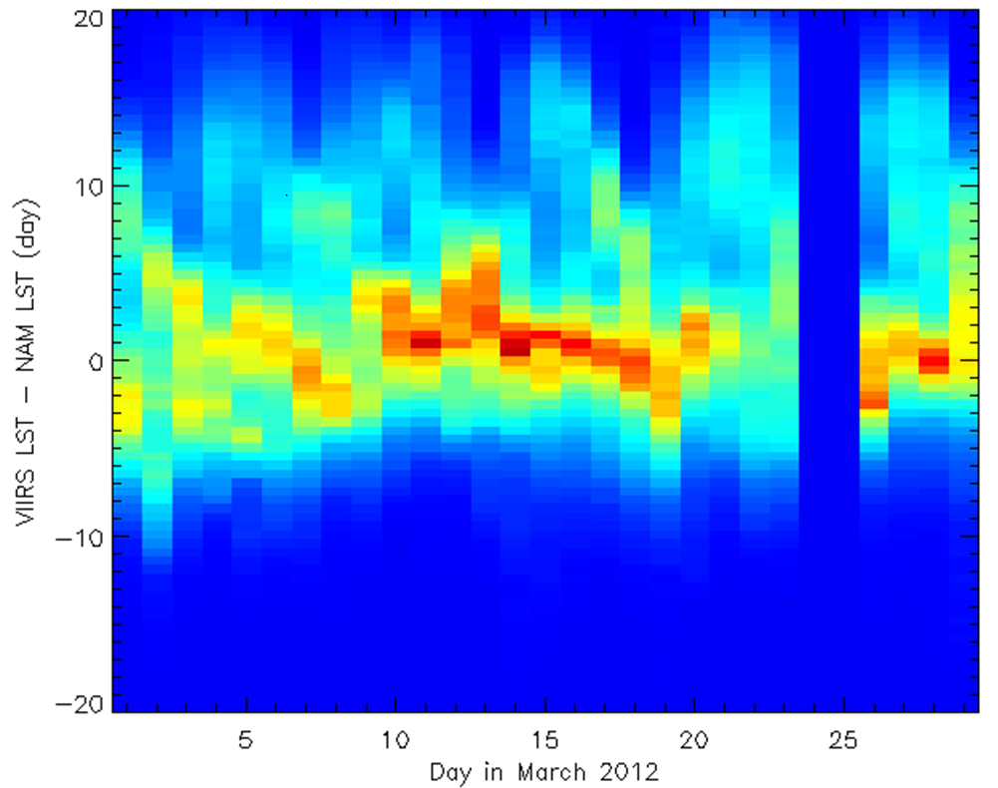
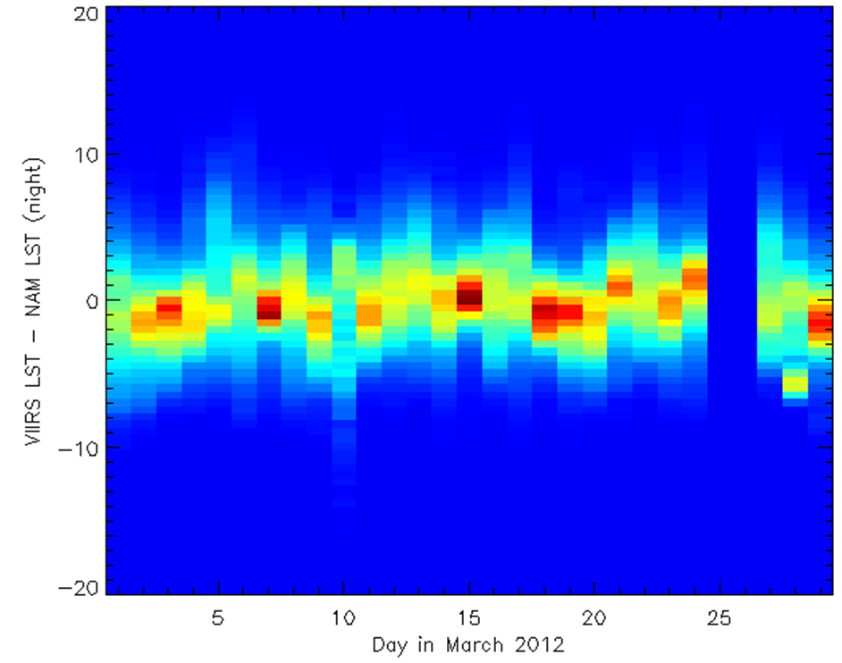
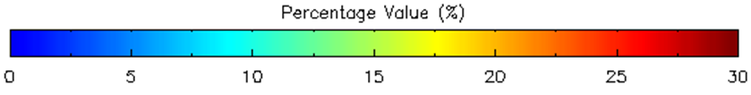
Model comparison
Comparisons to NAM (North American Model) over CONUS (5km) :

Slide 30
Conclusion
Cal/Val results summary
  Overall, VIIRS LST quality meets the L1RD requirement , based on the SURFRAD station in-situ LST estimates from Feb. 2012 to Aug. 2014.
  Quality of VIIRS LSTs and MODIS LSTs are similar, based on comparisons of over 100 VIIRS/MODIS SNO scenes.
  VIIRS LST production is stable, based on the weekly LST monitoring.
  Impact of sensor noise is ignorable; impacts of ST misclassification and cloud contamination are significant.
  over 60% error sources of the LST derivation can not be identified, due to quantitative and qualitative limitations of in-situ measurement.
  Practical uncertain is significantly larger than the theoretical analysis.
Improvement is needed
  Algorithm improvement
    emissivity explicit algorithm to replace the ST-dependent algorithm
    Coefficients stratification
  Validation improvement
    Global validation (South America, Australia, polar region data collection)
    Field Campaign , international cooperation
Notes:
Surface type input demonstrates a strong impact on LST quality using the real orbit data. The impact varies over surface type and day/night conditions. The misclassification from open shrub land could cause 3K error in LST, which is even beyond the accuracy requirement. The impact will increase if surface type becomes a yearly product

Slide 31
Path Forward
  Algorithm improvement
    emissivity explicit algorithm development, test, and evaluation
    Additional cloud filtering for LST production
  Water Vapor correction
    Coefficients stratification
  Angular correction
  Global /Comprehensive Validation
    Monitoring tool
    Global in-situ data collection (South America, Australia, polar region data collection)
    Upscaling model
    Cross satellite comparisons (MODIS, Sentinel, SEVIRI, AHI …)
  VIIRS LST data usage in NOAA climate model application
    Joint project with model group
Notes:
To account for the emissivity change within a surface type, emissivity explicit algorithm is recommended for the further improvement. Multiple emissivity explicit algorithms in literature are chosen in our test pool and preliminary test results are presented. More tests are necessary to finally determine which algorithm to use for JPSS future series.
Emissivity does not exist for current VIIRS data. Though there are several backups such as MODIS, Wisconsin emissivity database, Aster emissivity etc, some issues like latency, resolution etc make operational use difficult.

Slide 32
Impact of Surface Type Error
Impact on LST using real orbit data on Oct. 22, 2014, daytime (top-left) and nighttime(top-right)
Overall Statistics | Impact on LST
All-Day | 1.5K
All-Night | 0.8K
All | 1.2K
*Reference: Damien Sulla-Menashe, VIIRS ST V1 Quality Assessment April 02, 2014 EDR meeting
Notes:
Although the input error is acceptable from the simulation data analysis, the real data computation shows significant larger imapct.

